Slide 1
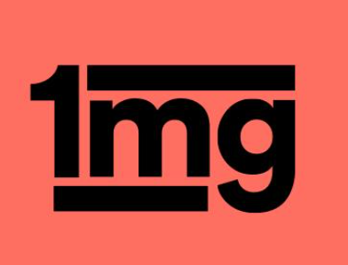

1 Mg Homeopathic
A Web Scraping Project

Slide 2

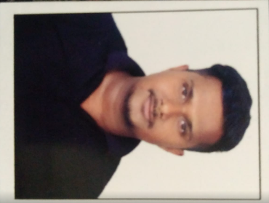
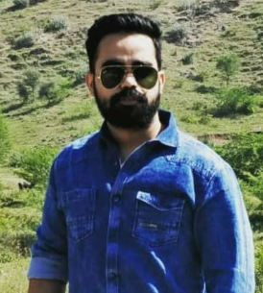

Team Members
Rahul Bisht
Prince Kr. Singh
Praveen Sharma
Rajat Tokas

Slide 3
01
03
02
04
Objectives
Scraped the site data and created a dashboard with useful insights.
Results analysis
Insights speak of :
Brands’ Market’s Standing
Most Used Ingredient
Reviews Rating
Price Analysis
Brand’s Key Focus Areas
Approach
Data scraping, data cleaning using Python IDE & its libraries
Data visualisation and insights generation using Excel and PowerBi
Conclusions
After analyzing the insights, we can suggest the useful ideas for upscaling the homeopathic store.

Slide 4
HOMEO INSIGHTS

Slide 5
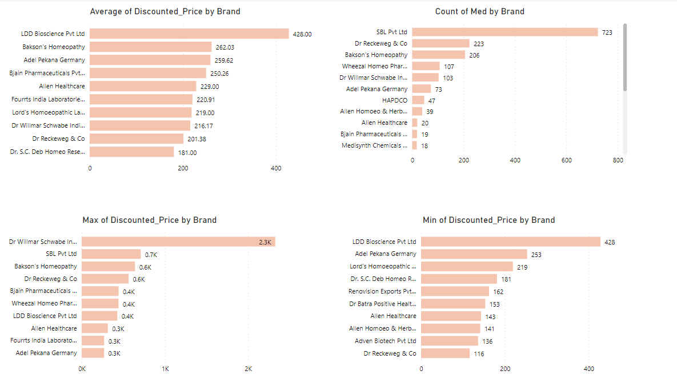
Brands’ Market Standing

Slide 6
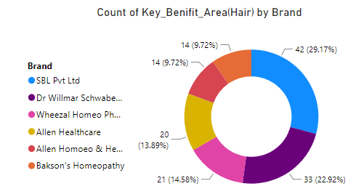
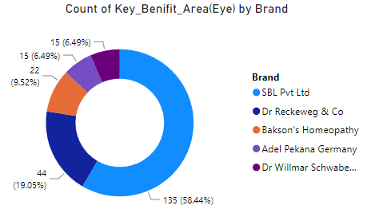
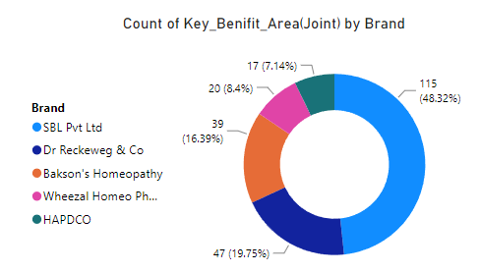
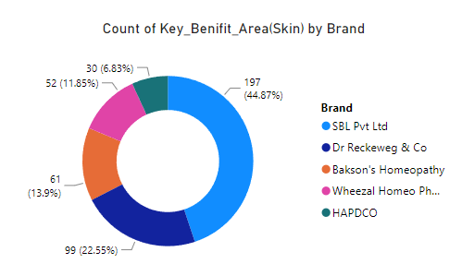
Brands’ Key Focus
BRANDS’ KEY FOCUS gives an insight about how the brands are targeting the specific body parts.
Key Focus are on :
Eyes
Hair
Skin
Joints
Eye-Hair
Skin-Eye
Skin-Hair
Joint-Skin
Join-Eye

Slide 7
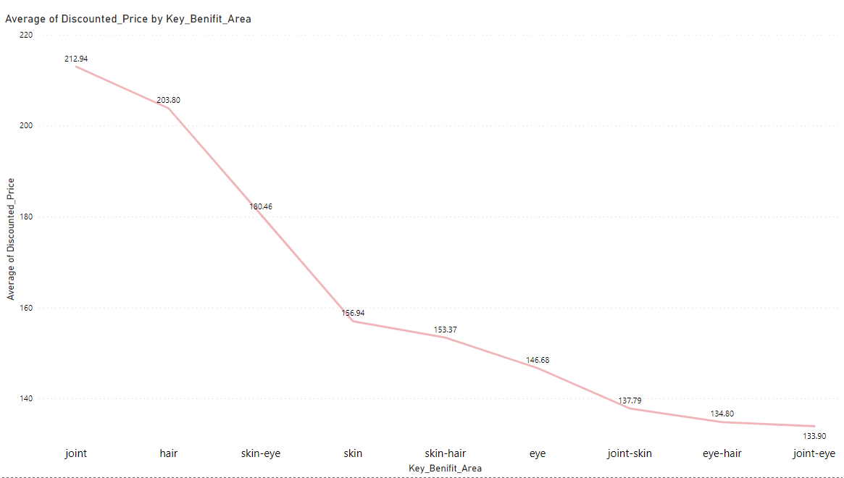
Price Range Of Medicine

Slide 8
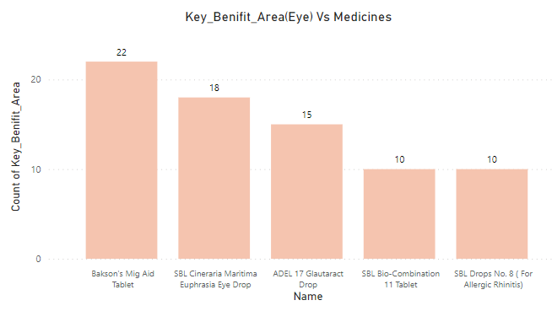
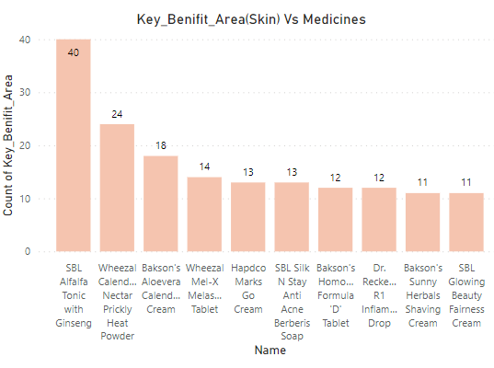
Most Trusted And Available Brand

Slide 9
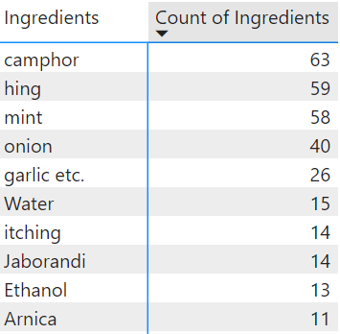
Most Used Ingredients

Slide 10
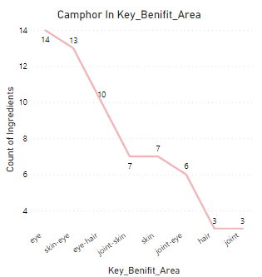
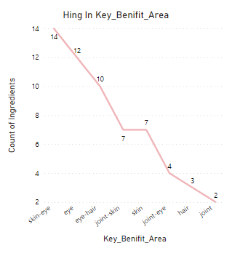
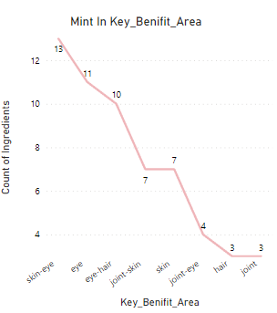
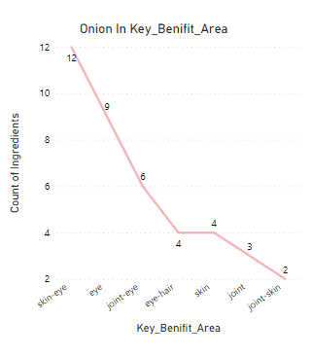
INGREDIENTS AND THEIR IMPACT

Slide 11
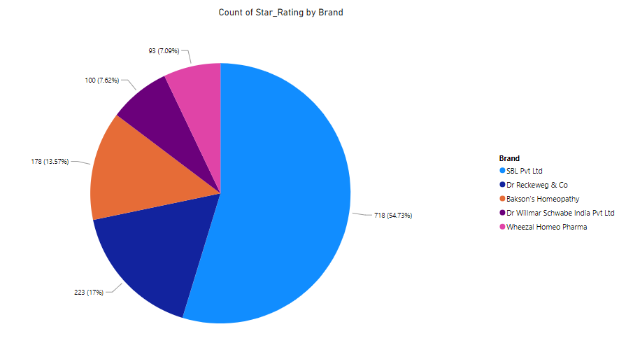
Super Rated Brand

Slide 12
DASHBOARD

Slide 13
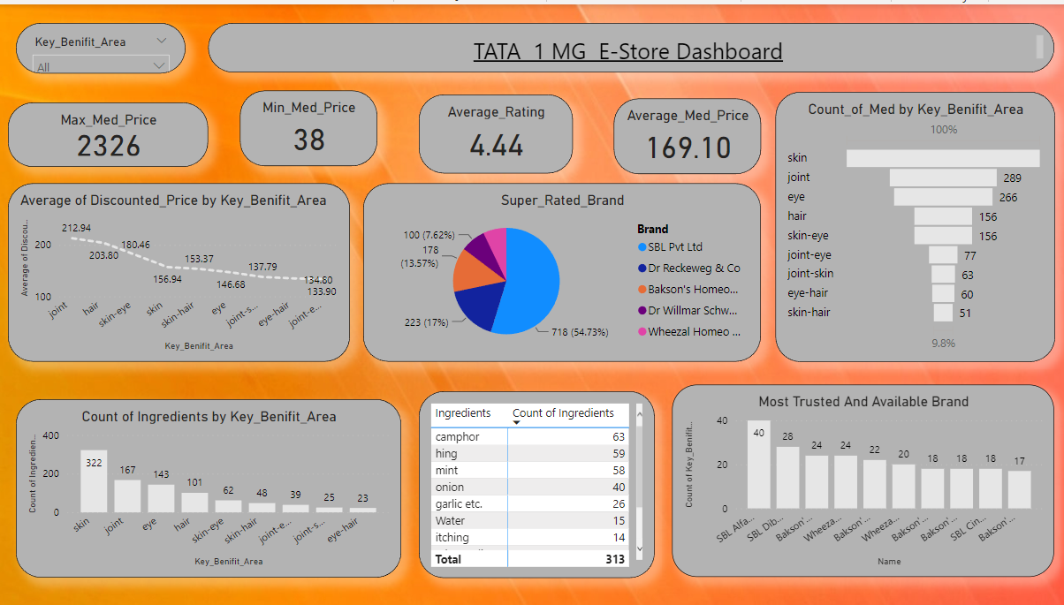

Slide 14
CHALLENGES FACED
CHALLENGES FACED
DATA SCRAPING & CLEANING
TIME MANAGEMENT
WORKING
ON EXCEL
Concept was new to us. We had to explore various sources to understand how it works. Then performing EDA on the data and segregating it were hard.
We are all from diverse fields, and work at different times. So we had to take individual ownership of tasks and ensure their timely completion.
Laborious, time-consuming efforts were taken on segregating the key benefit areas and targeting the key ingredients on Excel.

Slide 15
CONCLUSION
After analyzing the insights, we can suggest the homeopathic store, the following :
The most trusted and available brand is (i)Bakson’s Homeopathy and (ii)SBL Pvt Ltd.
The most economic brand is LDD Bioscience.
As per our analysis, SBL Pvt. Ltd. focuses on the entire Key body segments such as Hair, Joint, Eyes & Skin because of their highest listed medicines.
Average price by segments varies between
INR 213 to 134 max Price for joint and min Price for Joint-Eye
The most commonly used medicines:
Eyes – Bakson’s Mid Aid Tablet
Hair – Boericke Tafel Amica Shampoo
Joint –SBL Dibonil Tablet
Skin - Bakson’s Calceria Fluorica Tab

